Slide 1
Q Step & Nuffield Research Placements
Social Science Teachers & Advisors Day,
University of Leeds
13th February 2020
Chris Forde & Andrea Denny
Leeds Q Step Centre

Slide 2
Overview
What is Q Step?
Q Step at the University of Leeds
UG Summer Research Project Placements
Q Step and Year 12 Research Placements

Slide 3
Q-Step Programme
Q-Step is a £19.5 million programme designed to promote a step-change in quantitative social science training.
Developed as a strategic response to the shortage of quantitatively-skilled social science graduates. It is funded by the Nuffield Foundation, the Economic and Social Research Council (ESRC) and the Higher Education Funding Council for England (HEFCE).
15 universities across the UK awarded 5 year funding in 2013 to deliver specialist UG programmes, work placements and pathways to postgraduate study.
Expertise and resources will be shared across the higher education sector through an accompanying support programme, which will also forge links with schools and employers.
For more information go to www.nuffieldfoundation.org/q-step and www.qstep.leeds.ac.uk

Slide 4
Q Step at Leeds
Social Sciences, Business, Environment ,
Arts & Humanities
Q Step pathways on programmes
New quants modules & embedding
Student & staff training in quants skills
UG Summer Placements
Schools engagement activities
Nuffield Research Placements (link to national scheme)
Today’s Focus:
UG summer research placements
Summer 2020
align with
Nuffield Research Placements
–
Opportunities for Year 12 students

Slide 5
UG summer research placements
Week-long research methods training course (mid-June) to develop skills, confidence and interest in using quantitative research methods.
PAID 4 week research project placements (late June – July) covering a wide-range of subject disciplines across the arts, humanities, business, education, environment, social sciences and law
Great opportunity for students, research staff and external organisations to benefit from collaboration on a live research project.
Enabling UG students to make a significant research contribution to a wide range of research projects across the social sciences
Develop skills and gain experience that will be useful to final year UG study, PG study and future employability.

Slide 6
Widespread Subject Range – 2019 Projects
Diversifying the story of the French Internal Resistance
Final year undergraduate research projects: Equal expectations, experiences and outcomes for all?
BEST (Belonging and Engagement for Successful Transition to Higher Education)
Establishment of a Q Step student and alumni network at Leed
Global Productivity Puzzle
Skipton’s First World War Prisoner-of-War Camp
What impacts the music in our ‘mind’s ear’?
MPs use of Twitter during times of crises (Brexit negotiations) & non-election periods
Forecasting domestic water demand - sensitivity testing of sub-national population projection models
Exploring community acceptance of large-scale solar farms
Spatial factors affecting persuasive messaging for public transport
Travel behaviour, local road condition, and public satisfaction
Conflicts between recreational user groups & possible management solutions (Ilkley Moor)
Exploring the effect of personal experience of extreme weather on emotions, climate change concern, & pro-environmental behaviour
Queer Memorials: International Comparative Perspectives on Sexual Diversity & Social Inclusivity
Leeds City Council: Defining the Leeds City Centre Boundary
The Political Consequences of Natural Disasters
Mapping the Correspondence Network of Zygmunt Bauman
Measuring proportionality in sentencing
Inclusive Public Space: Law, Universality & Difference in the Accessibility of Streets
Environmental Behaviour and Attitudes in Germany 1996-2016
Critical issues in the professional socialisation of black students in accounting education
How does personality influence decisions when people are competing with each other?
Mining comparative statements from textual data for multi-criteria decision analysis
Investigating ways of structuring decision-making problems
Communicating uncertainty in weather warnings
The characteristics of firms and countries as determinants of international mergers & acquisitions – acquiring firms
The characteristics of firms and countries as determinants of international mergers & acquisitions –acquired firm
What factors affect employee engagement at Leeds NHS Trust over time?
Analysing the experiences of colonial soldiers in the French Army during WW1

Slide 7
Benefits: Skills & Experience
Research experience on live research projects
Communication skills (verbal & written)
Critical thinking & analytical skills
Valuable research experience and skills development
Technical data skills – stats, data analysis
Project management skills
Time management & organisation skills
Develops students’ knowledge and a range of graduate level skills
Formal recognition of skills on degree transcript (HEAR)
Builds confidence as well as competence!

Slide 8
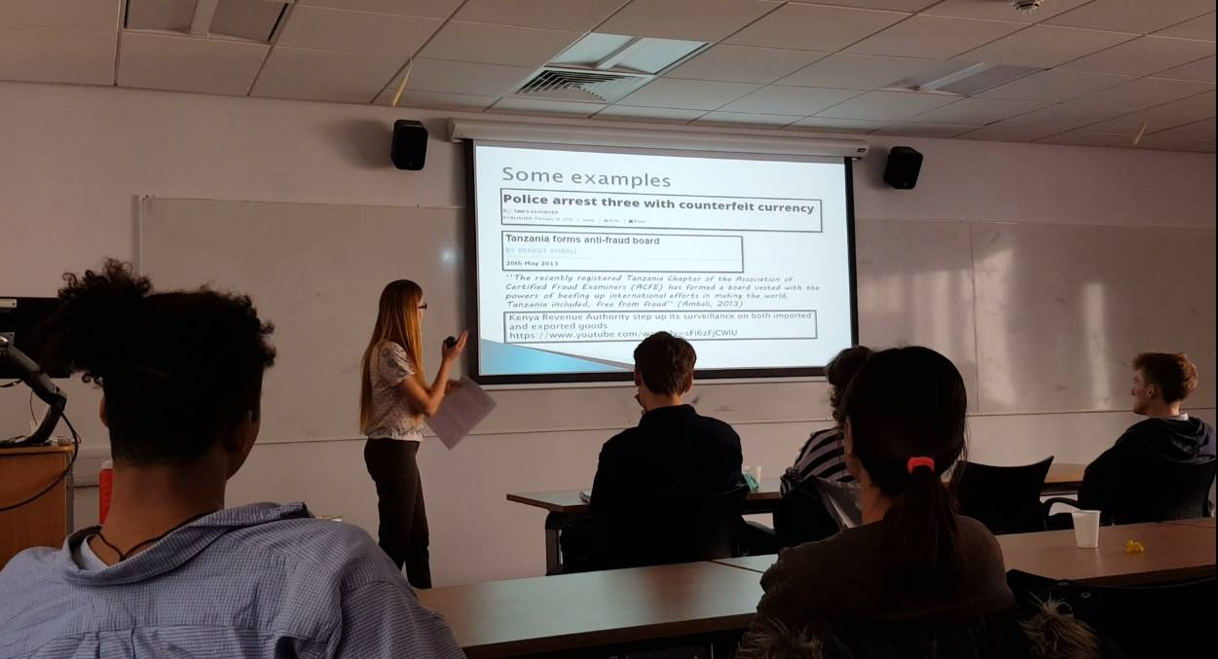
Longer term benefits
Research outputs contribute to academic publications, policy development & practice
Data literacy & research skills help with final year modules, dissertations & PG study
Ongoing skill development – student presentations , blogs, conferences related to placements
Future employability – graduate level skills, networking , career choices and opportunities
Placements highlight transferable skills of social science graduates to employers

Slide 9
Student feedback
extremely valuable experience in so many ways
I have loved my time during the Q Steps Summer Research Project Placement.
The project was a fantastic and enriching experience, and has been a great springboard into the world of academic research and quantitative analysis.
I took on real responsibilities from day one, which can be applied to any career. Also my work contributed to research that will be published in an academic journal. This placement will help me write my dissertation that I will hopefully publish. Time management will be helpful during third year.
The Q step programme was an overwhelmingly positive experience for me. At the same time as learning a lot of new technical skills, I have also gained valuable experience of researching and working in a formal environment.
The placement greatly improved my research, critical thinking and analytical skills and has also improved my data analysis skills. Most importantly, it has given me the confidence to carry out mini research projects of my own.
This placement will help me to stand out from the crowd and offer something that not many people could also offer.
The experience in quantitative and qualitative skills that I now have is invaluable and will improve the quality of my academic work as I go into the final year of my degree massively. it has confirmed my intentions to pursue post-graduate study and has given me transferrable and valuable skills for the workplace.

Slide 10
Project leader feedback
The intern worked very effectively and been instrumental in the success of a scoping project with Land Securities and we hope this will lead to further collaborative research.
The project intern provided us with a very valuable report and analysis.
We were both very impressed with the intern’s work on the project, which has made a significant contribution to our group’s ongoing research on climate risk preparedness.
The programme has worked immensely well and I think from both sides the experience has been fantastic and her outputs have been commensurate with a PhD student’s. I have been really impressed with the organisation of the internships and would very much like to see them to continue.

Slide 11
Q step links to Year 12 Social Science Placements
Nuffield Summer Research Placements
http://www.nuffieldfoundation.org/placements
4 to 6 week summer placements, for A-Level or equivalent students to work alongside scientists, including quantitative social scientists
Placement Scheme traditionally STEM subjects, but is being extended to social sciences through Nuffield’s partnership with Q Step Centres

Slide 12
What is a Nuffield Research Placement?
When?
Summer holidays after Year 12 (England, Wales & Northern Ireland) or S5 (Scotland)
How long?
4 – 6 weeks
What?
A well-supervised but independent research project relating to an area of science, quantitative social science, computing, technology, engineering or maths (or a combination!)
Where?
Placements take place in a variety of locations including offices, museums, research centres, laboratories or fieldwork settings.
Costs?
Students can take part in a placement at no cost. Travel costs are reimbursed and students may be eligible to receive a £100 bursary each week.

Slide 13
2019 NRP Stats
963
students placed in 2019
175
organisations offered to host a placement in 2019
100%
of students placed are from low socio-economic backgrounds

Slide 14
Eligibility Criteria
To be eligible, students must:
Be over 16 years old and in Year 12 or S5.
Be in full-time state-funded education in the UK.
Have at least 5 GCSEs at Level 6 or above OR Scottish Nationals at Level B or above, including maths, a science subject and English (or another humanities subject).
Be studying one or more A-level, Scottish Higher (or equivalent) in science, technology, engineering, economics, geography, psychology, computing, statistics or maths.
Be available for 4-6 weeks of their summer holiday.
Students must also meet at least one of the following criteria:
Be living, or have lived in, local authority care.
Come from a family with a combined household income of below £30,000 a year, or be entitled to free school meals, either now or at any time in the last 6 years.
Be the first in their immediate family to participate in higher education (not including any older siblings).
This means neither of their parents/carers have participated in higher education, either in the UK or another country. If their siblings have attended higher education, but their parents/carers have not, they are still eligible.

Slide 15
Success of NRPs
Interim evaluation report – impact of NRPs on the education and outcomes of students:
https://www.nuffieldfoundation.org/wp-content/uploads/2019/12/NRP-Evaluation-Interim-report-June-2019.pdf

Slide 16
Initial findings
Nuffield Research Placements have a positive impact on participants’ access to STEM higher education courses. Nearly a third (32%) of participants enrolled in a STEM course in a Russell Group institution, compared to 25% of comparable pupils with similar demographic background and academic attainment.
The programme is successfully targeting students from more disadvantaged backgrounds: 22% of pupils offered a placement between 2014 and 2016 were eligible for Free School Meals in the six years prior to the offer.
Participants reported that the placement enhanced their study motivation, overall. These skills are beneficial both for confidence in abilities and specific skills in presenting, writing and time management employment within STEM and for their transferability to employment in other areas.

Slide 17
Aligning NRPs with UG Summer Placements at Leeds
Academics and research centres invited to host NRP placement alongside UG placement in summer 2020
NRP students attend quants training workshops during their placements
NRP students gain similar knowledge, skills and experience as UG student researchers
Also wider (aspiration raising) benefits from working alongside UG student researcher
PhD student mentoring support to UG & NRP student researchers

Slide 18
Recruitment of Yr 12 students
Leeds Q Step Centre provides placement projects
Recruitment of Yr 12 students to placement projects is coordinated by NRP regional contacts
David Ward
Yorkshire and Humberside Regional Coordinator
davidwardsalford@aol.com
07939 148 839 or 0161295602
The Greater Manchester STEM Centre,
Technology House,
2 Lissadell Street,
University of Salford,
Salford, M6 6AP

Slide 19
Timeline
Early March
Available NRP social science research project placements at University of Leeds confirmed
Late March/ April
Information session for Year 12 students – placement projects
Suggestions on format & date?
By 12 April
Deadline for student applications via Setpoint
Setpoint to discuss and agree placement allocation with applicants
Late June / early July
Selected students start 4 week placements at University of Leeds
Suggestions – earliest start date?

Slide 20
Questions
Thanks for listening

Slide 21
Further information & Contact
Professor Chris Forde: C.J.Forde@lubs.leeds.ac.uk
Andrea Denny: a.j.denny@leeds.ac.uk
Leeds Q Step Centre: www.leeds.qstep.ac.uk
Nuffield Research Placements: http://www.nuffieldfoundation.org/placements

